Slide 1
Winter is Here … I Think
Remembering some fun times from past seasons. Looking forward to making new memories.

Slide 2
Ahhh, Winter …

Slide 3
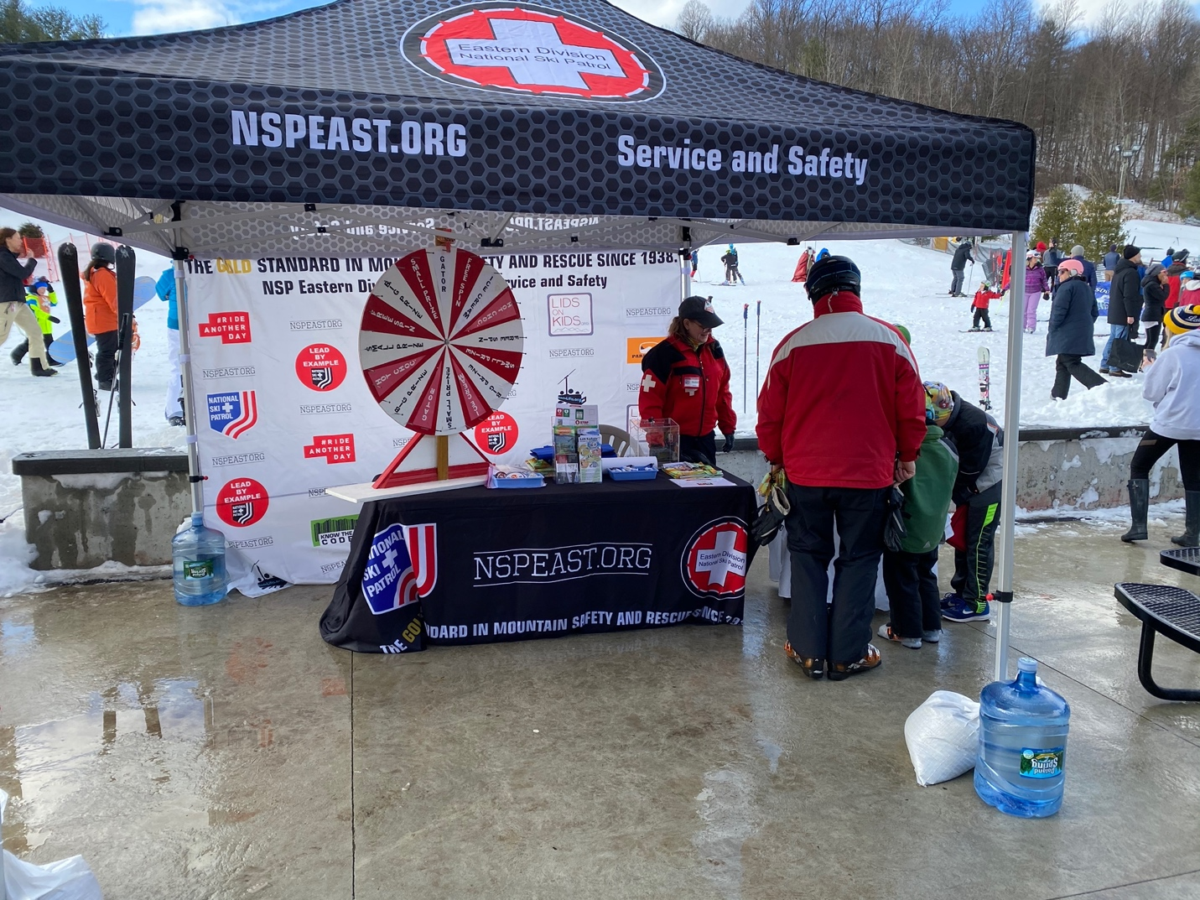
Thanks to our Safety Teams

Slide 4
And Our Alumni Patrollers

Slide 5
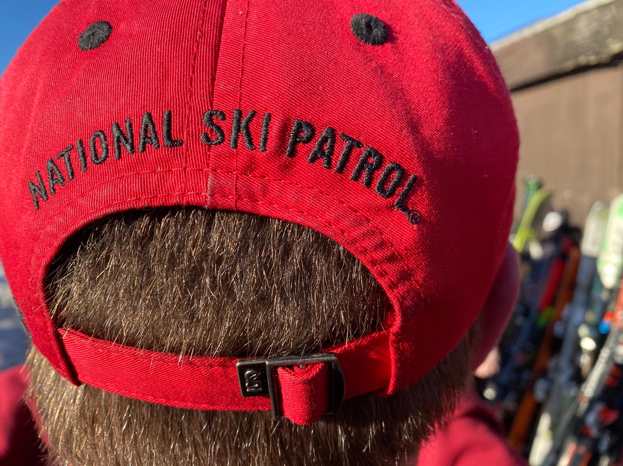
Proud to Wear the Cross

Slide 6
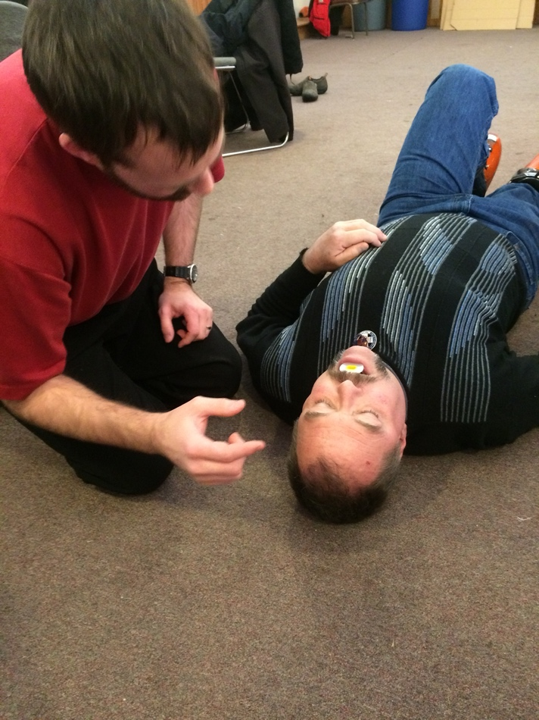
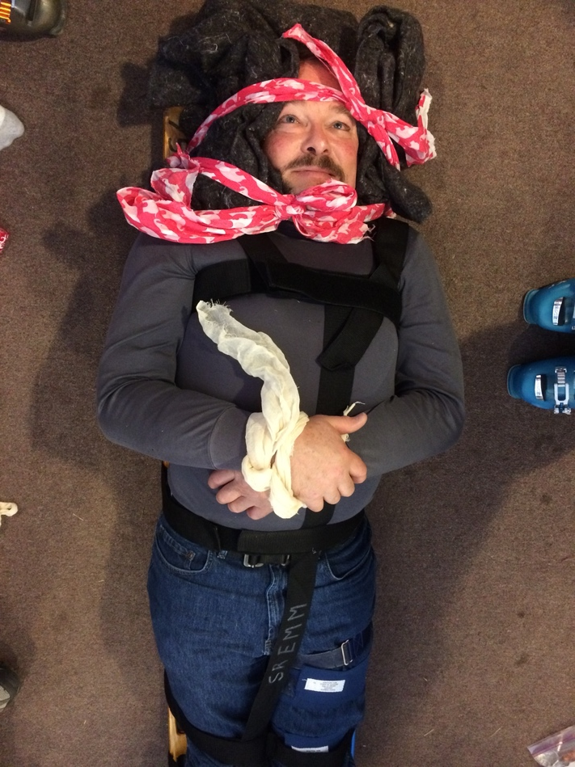
Let’s See, There is OEC Fun (Thanks, Steve!)

Slide 7
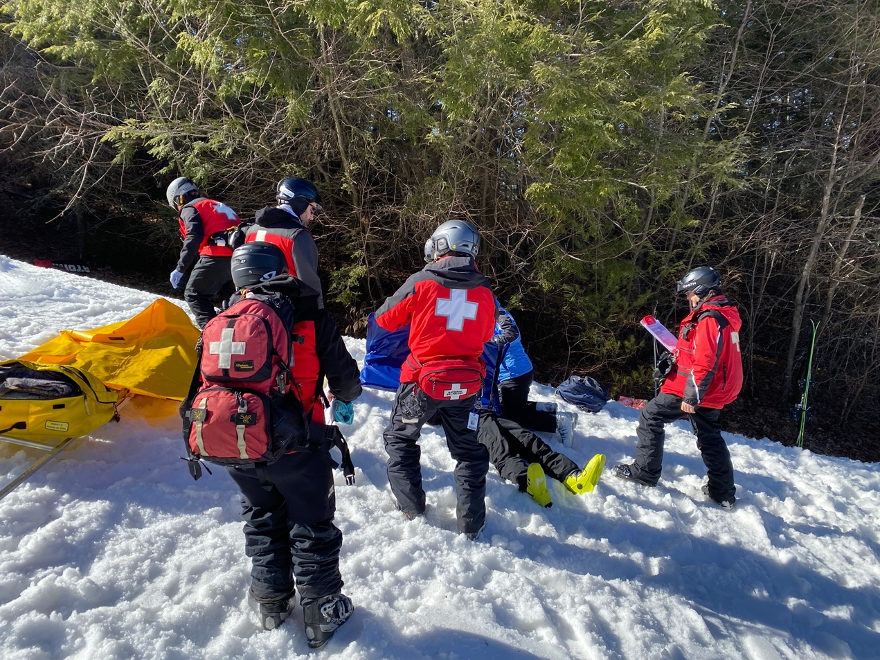
Even OEC Outside …

Slide 8
And How About OET Fun?

Slide 9
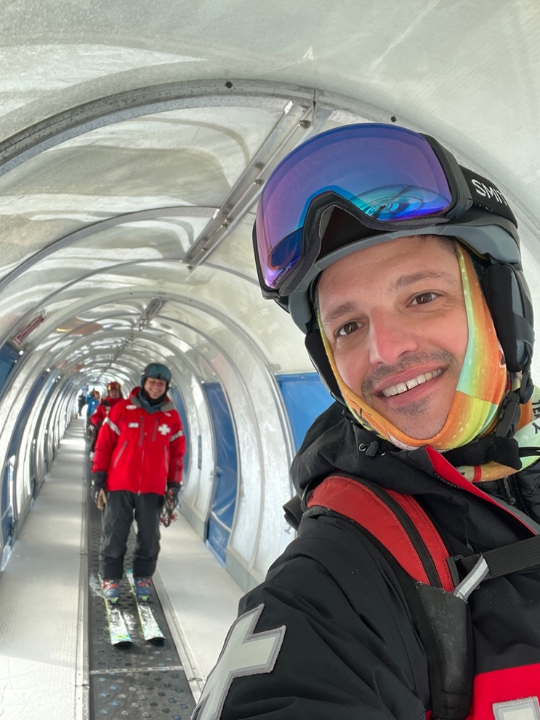
And Let’s Not Forget Senior OET Fun

Slide 10
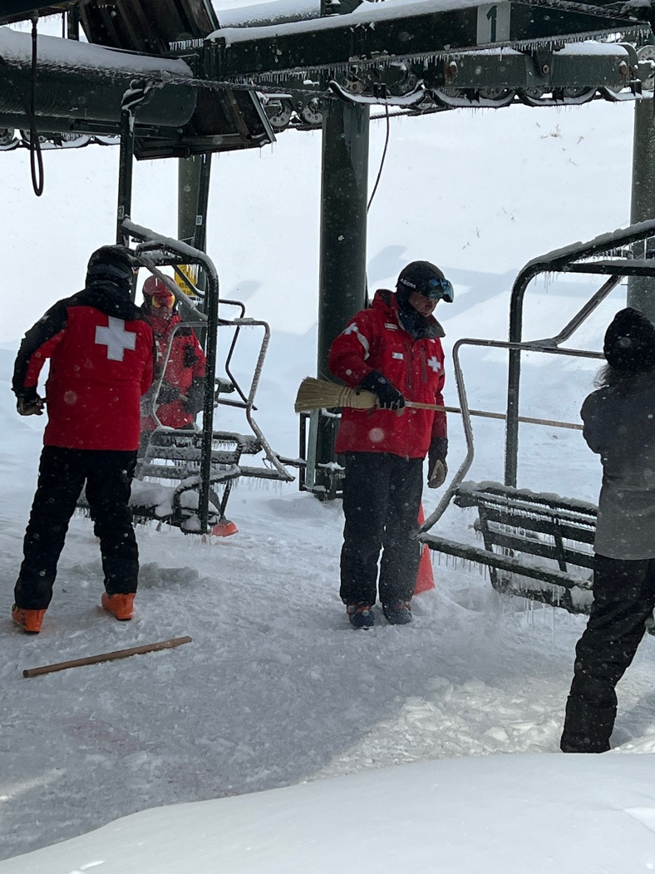
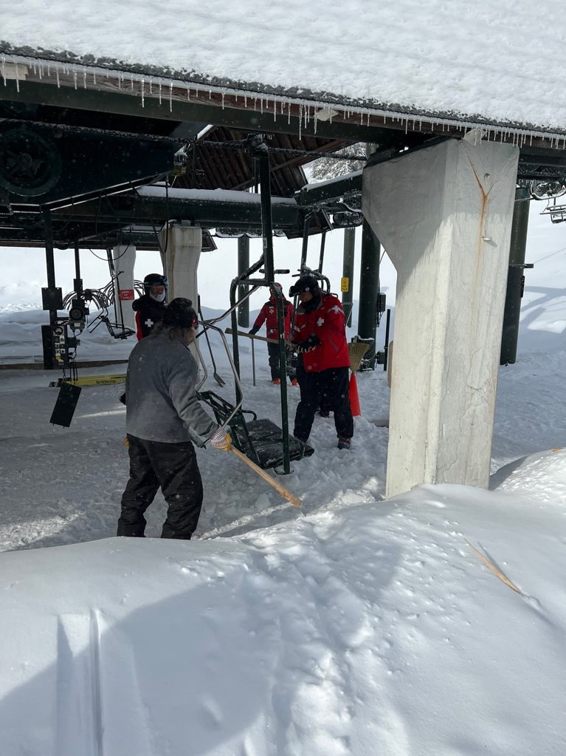
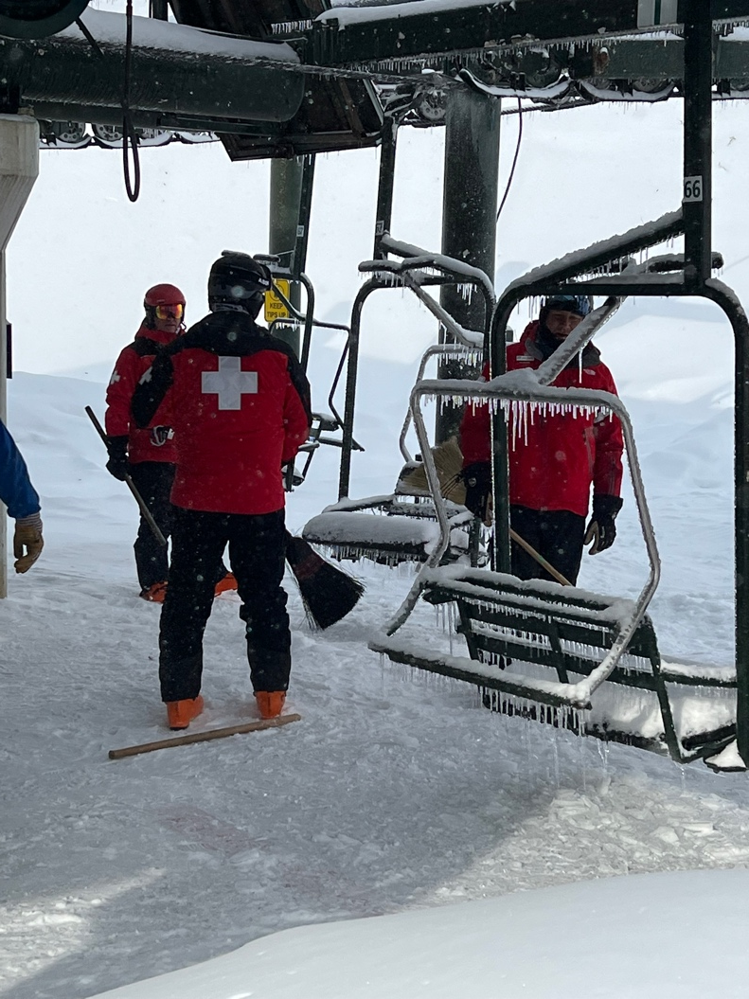
Sometimes They Had to Work For Their Fun

Slide 11
And More Work …

Slide 12
But Then They Got to Really Play!

Slide 13
And Let’s Not Forget MTR, Making Their Own Fun

Slide 14
Thanks to Our Talented MTR Instructors!

Slide 15
And How About Letting Our Hair Down and Just Being Ourselves?

Slide 16
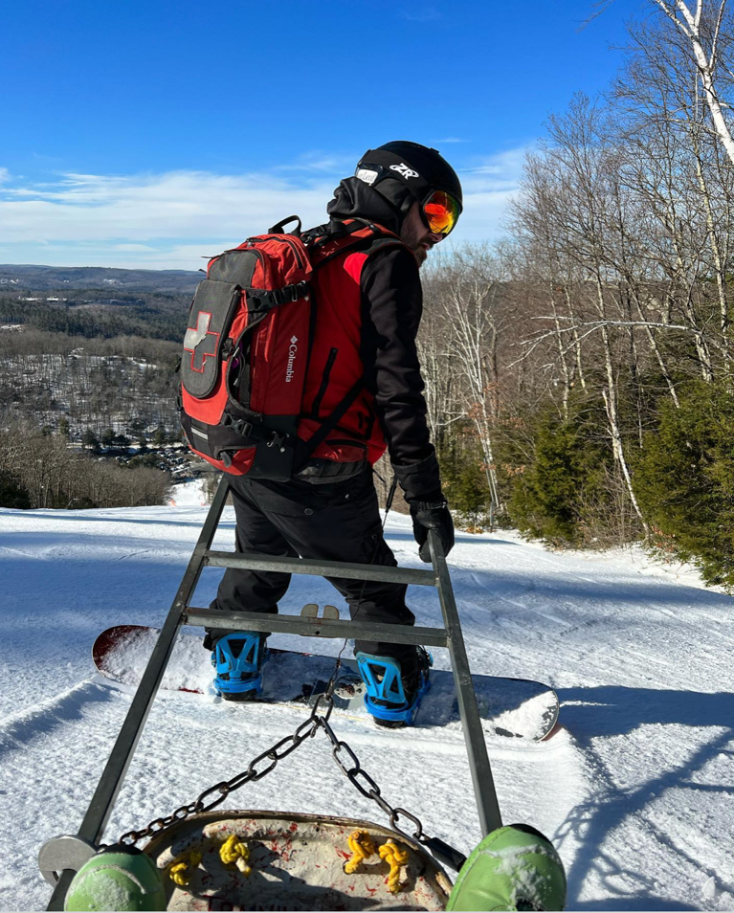
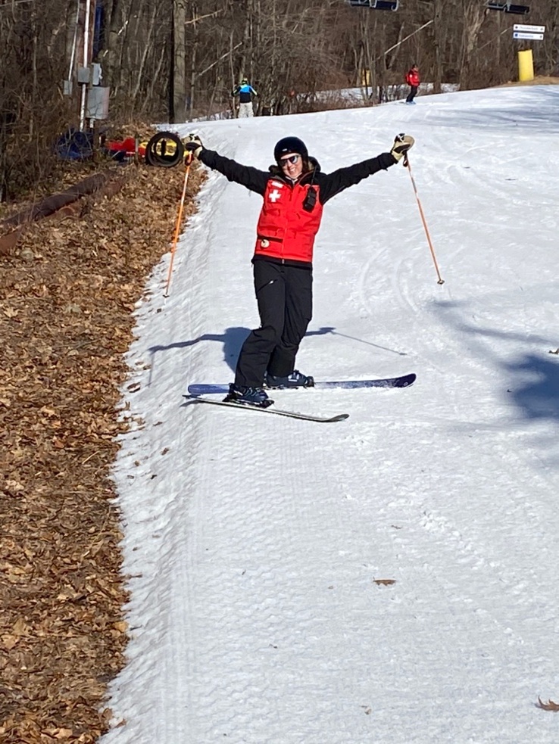
So As We Bid Farewell to Seasons Past, Let’s Make Some New Friends, Experiences, Memories and Have Some Fun!

Slide 17
To Our Patrol Family …
Looking forward to learning more
Helping those in need
Welcoming new members of our family
Creating new and stronger relationships as we support one another.
Thank You!!

